Slide 1



Weekly report: Machine Bed & Yaw System
Week # 3
Date: 14/10/2025
Supervisor: Prof. Quell Peter
Group members: Shoukat Abbas, Luksh Chawla, Sathishkumar Venkatachalam, Shrihari Kadam
14/10/2024
1
Luksh Chawla

Slide 2
Contents
3-Point Suspension Example Optimus-92
3-Point Suspension Design Requirements for Machine Bed and study model
The Free Body Diagram
The Objective & Scope of the Load Transfer Tool
Accurate Loads: From Input to Design Check
Yaw Bearing Diameter Estimation
Reference
14/10/2024
Luksh Chawla
2

Slide 3
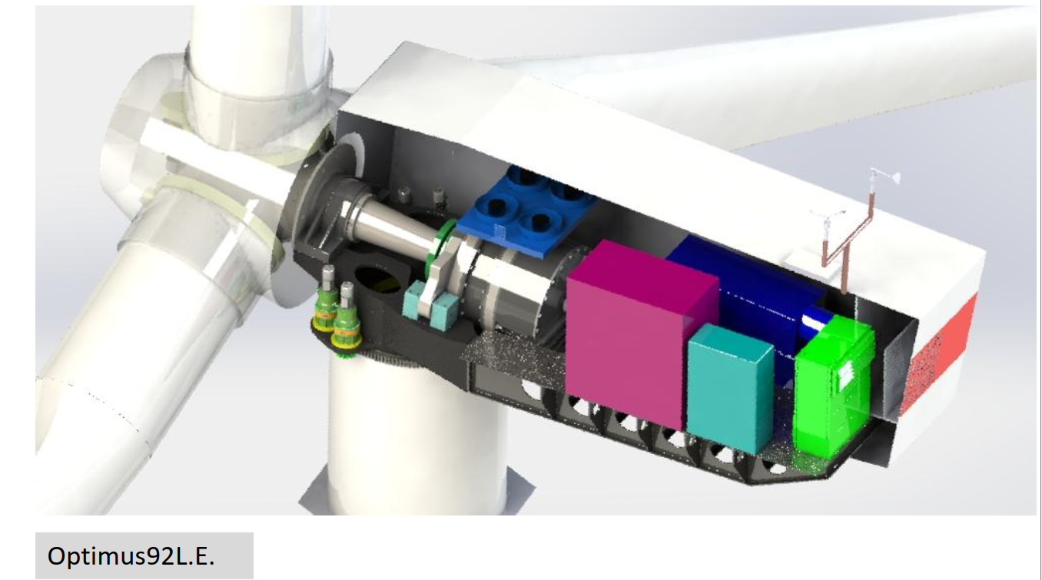
3-Point Suspension Example Optimus-92
Suspension system 3-Point Suspension (Main Bearing + 2 Torque Arms) Main Bearing Double-row spherical roller bearing Yaw Bearing Four-point Roller bearing Yaw Systems Electric yaw drives + brakes + control loop[1]
14/10/2024
Luksh Chawla
Machine Bed & Yaw System/Optimus syria

Slide 4
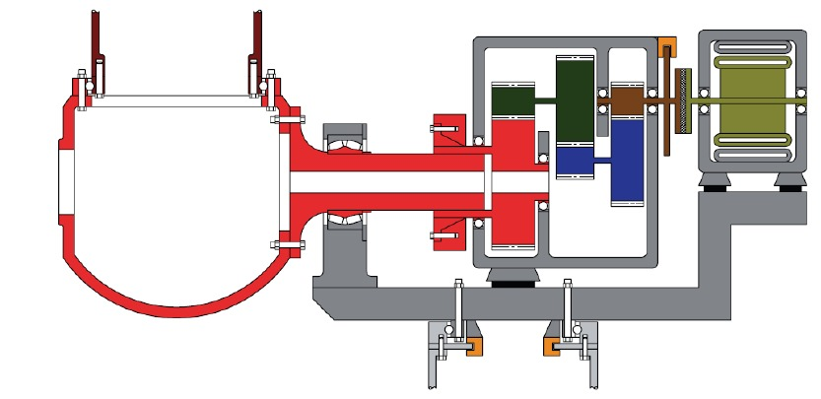
Design Requirement for Bed Plate with 3-point Suspension
1. Rigid bedplate structure (steel cast/welded) with high fatigue strength. [2]
2. Supports must form a wide triangle for stiffness & stability.
3. Load transfer: rotor → bearing → gearbox → bedplate → tower.
4. Limit deflection & misalignment between shaft and gearbox.
5. Dynamic design – natural frequency above main excitation range.
6. Thermal & vibration isolation at each support.
3-point suspension concept from lecture drivetrain
14/10/2024
Luksh Chawla
Machine Bed & Yaw System/Optimus syria

Slide 5
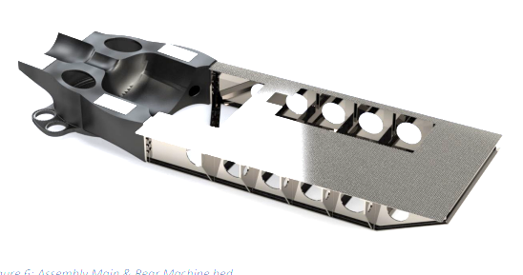
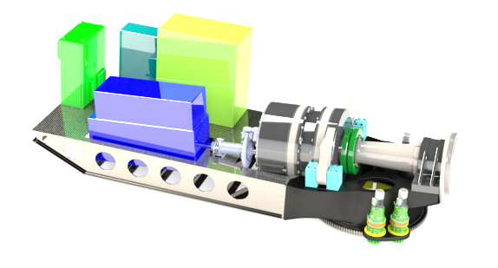
Study Models For Bed plate - Optimus 92 LE with Hybrid Str.
Optimized Load Transfer: Main bearing and torque arm supports positioned above tower radius ensure efficient load flow into the tower with minimal deformation.
Structural Efficiency: Cast iron (EN-GJS-400-18-LT) bed with variable wall thickness and smooth transitions reduces stress concentration while maintaining stiffness and low weight.
Functional Integration: 5° tilt provides rotor tip clearance; welded rear truss with cross-girders improves torsional rigidity and simplifies maintenance access.
14/10/2024
5
Luksh Chawla
Machine Bed & Yaw System/Optimus syria

Slide 6
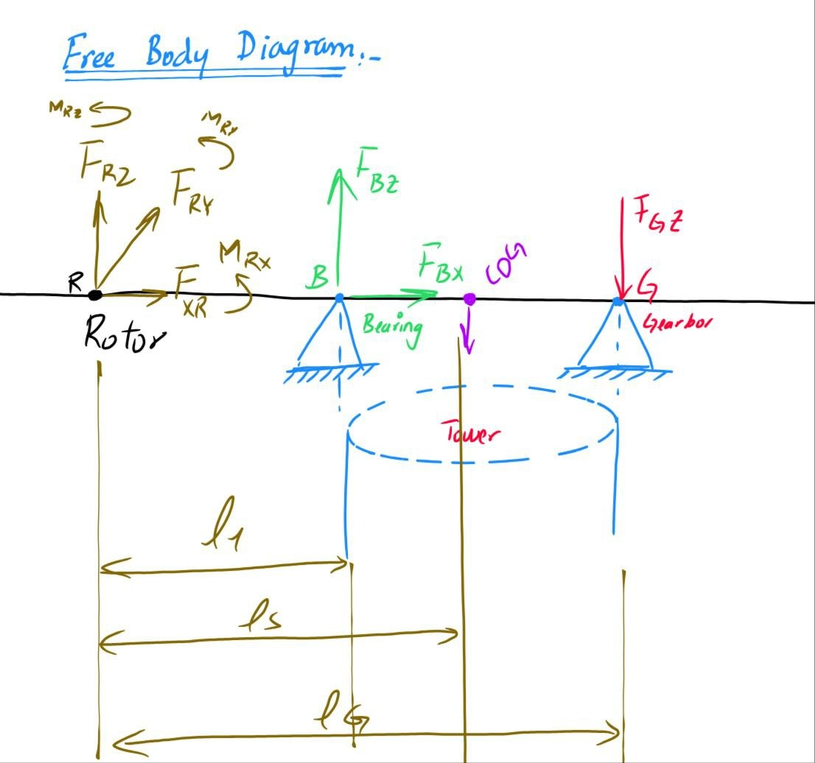
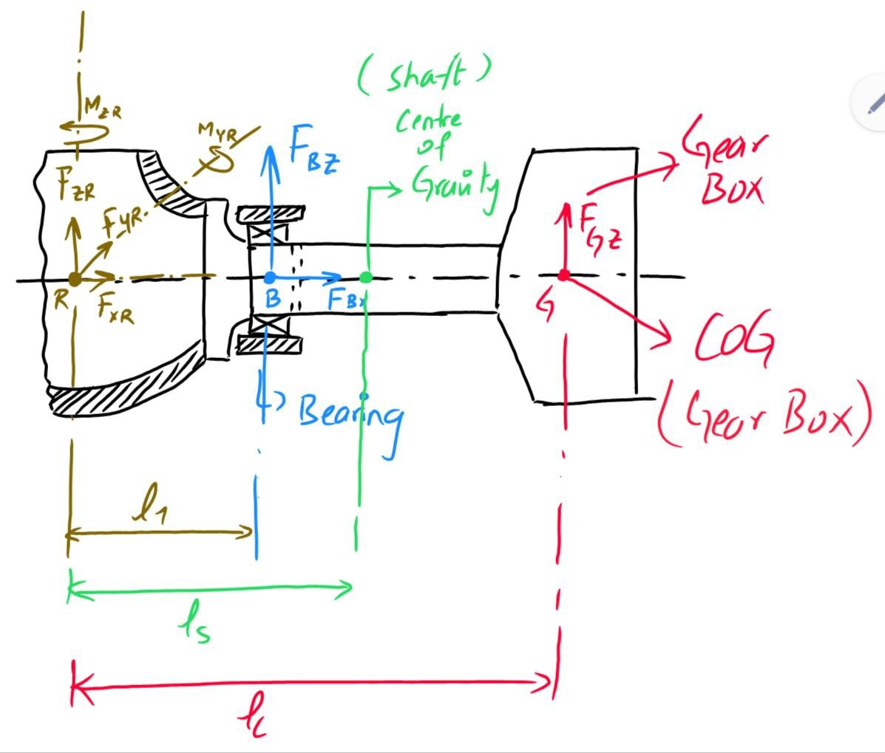
The Free Body Diagram
6
Machine Bed & Yaw System/Optimus Syria
14/10/2024

Slide 7
The Objective & Scope of the Load Transfer Tool
Objective:
To accurately calculate the Reaction Forces on the machine bed's three support points. We need these forces to size the structure. Input:
Rotor Loads (Fx​,Fy​,Fz​) from the Rotor Coordinate System. This is the raw data from the blades. Output:
Precise loads for the Main Bearing and Torque Arm Stands. These numbers are critical for 3-point suspension design. Value:
It ensures Statically Determinate Support by providing reliable force data for a strong, easy to level bed.
14/10/2024
7
Luksh Chawla

Slide 8
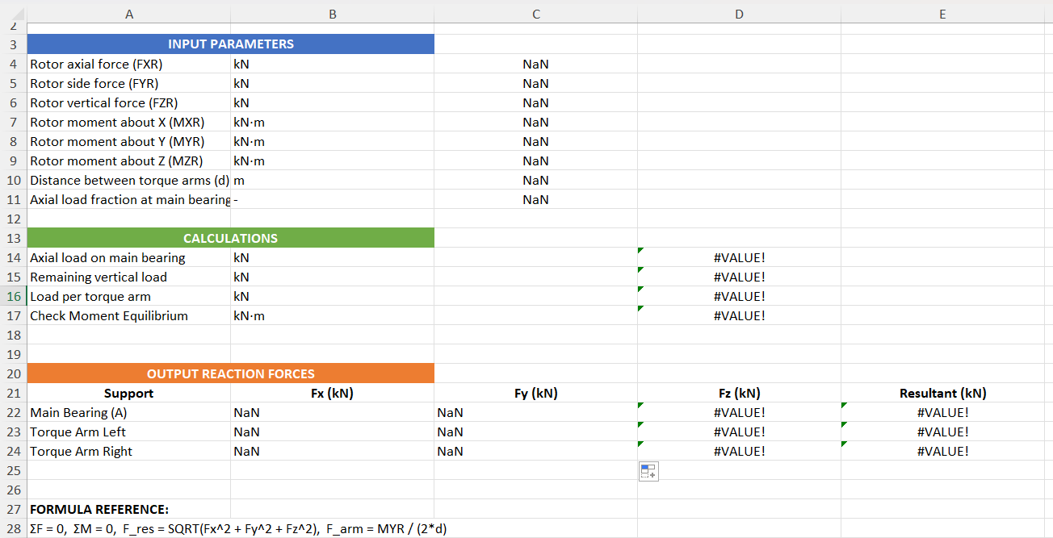
Accurate Loads: From Input to Design Check
Quick Results:
Enter rotor forces → get bed support reactions instantly.
Method:
Uses static equations (ΣF = 0, ΣM = 0) for load transfer.
Design Use:
Helps check torque-arm strength and main-bearing sizing.
[3]
14/10/2024
8
Luksh Chawla

Slide 9
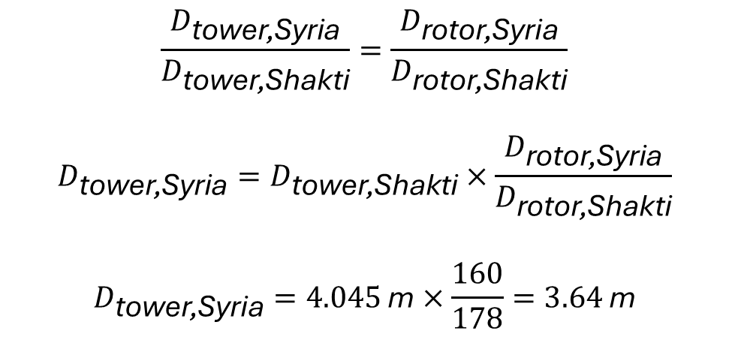
Yaw Bearing Diameter Estimation
Yaw Bearing Diameter:
Influencing with tower top diameter. In contact with the “tower team”, the top diameter is likely to be around 3.5m.
$$\frac{D_{\text{tower}\text{,}\text{Syria}}}{D_{\text{tower}\text{,}\text{Shakti}}}=\frac{D_{\text{rotor}\text{,}\text{Syria}}}{D_{\text{rotor}\text{,}\text{Shakti}}}$$
$$D_{\text{tower}\text{,}\text{Syria}}=D_{\text{tower}\text{,}\text{Shakti}}×\frac{D_{\text{rotor}\text{,}\text{Syria}}}{D_{\text{rotor}\text{,}\text{Shakti}}}$$
$$D_{\text{tower}\text{,}\text{Syria}}=4.045 \text{m}×\frac{160}{178}=3.64 \text{m}$$
Geometric scaling: Final yaw bearing diameter must be verified by yaw-moment and contact-load calculations or supplier data, verification from Prof.
14/10/2024
Luksh Chawla
Machine Bed & Yaw System/Optimus syria

Slide 10
References
Report_Optimus92LE_Machinebed_Yawsystem_Rev1.pdf[1]
https://www.osti.gov/servlets/purl/13413[2] A Systems Engineering Analysis of Three-Point and Four-Point Wind Turbine Drivetrain Configurations," Wind Energy (2016).
3point_load_transfer_tool_v2.xlsx[3]
8
Machine Bed & Yaw System/Optimus Syria
14/10/2024

